Slide 1
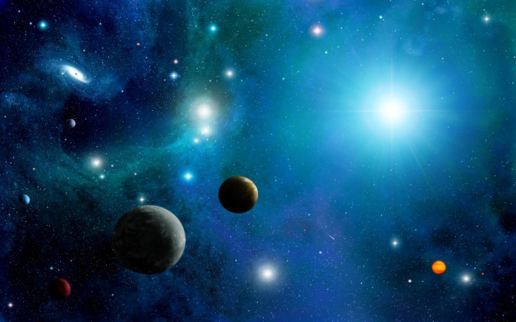
Exoplanets hunting
By Sneha KK

Slide 2
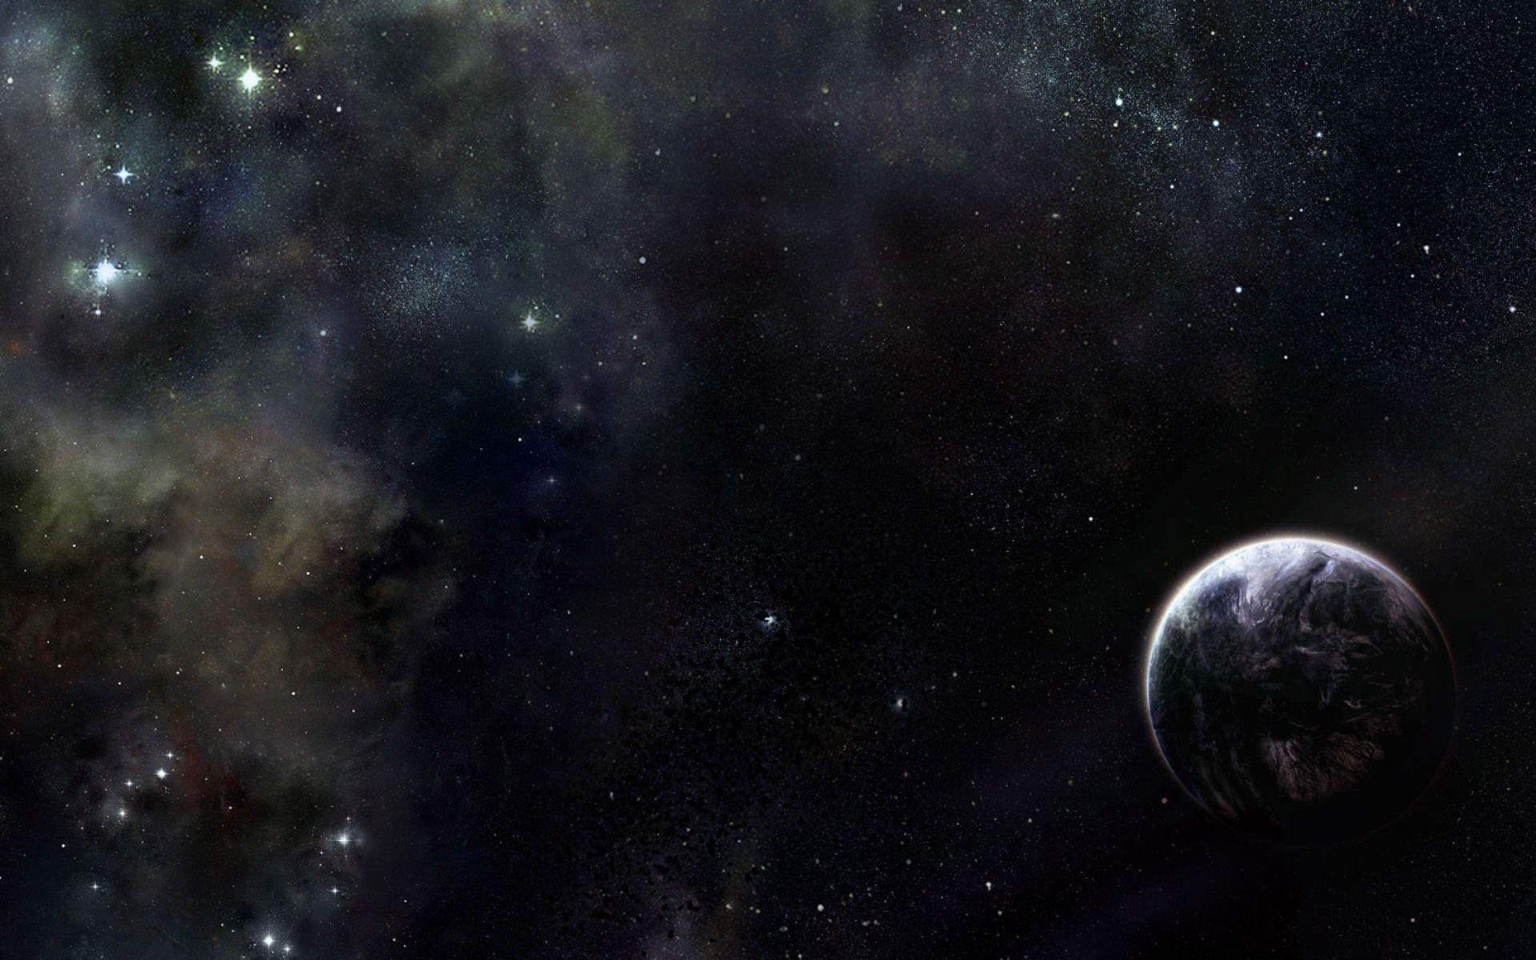
Exoplanets * Exoplanets are planets that orbit stars outside our solar system. * These planets are further studies by astrophysicists for possibilities of alien life, and to deepen our understanding of the universe. * A KOI is a target identified by the Kepler Project that displays at least one transit-like sequence within Kepler time-series photometry that appears to be of astrophysical origin and initially consistent with a planetary transit hypothesis. * NASA's Kepler's Objects of Interest(KOI) table can be used to train models to recognize candidates for exoplanets using the properties of KOI objects as features.

Slide 3
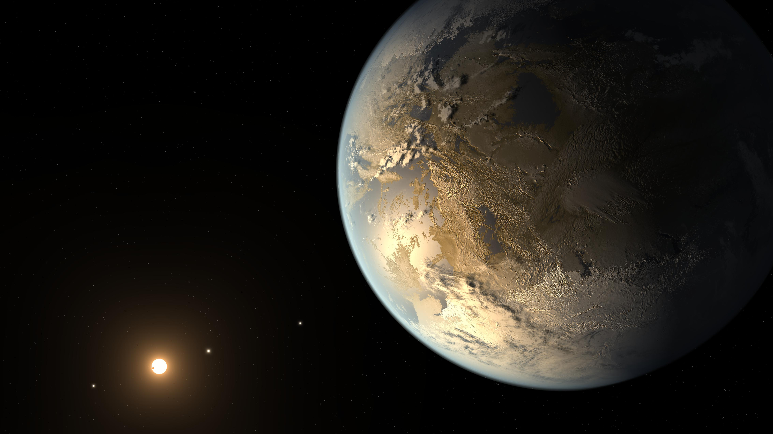
Kepler-186f was the first rocky planet to be found within the habitable zone -- the region around the host star where the temperature is right for liquid water. This planet is also very close in size to Earth. Even though we may not find out what's going on at the surface of this planet anytime soon, it's a strong reminder of why new technologies are being developed that will enable scientists to get a closer look at distant worlds.

Slide 4
In this project, we aim to analyze data collected by NASA's Kepler telescope on astronomical objects to find out the typical characteristics of an exoplanet. We will then build machine learning models to predict whether a given KOI is an exoplanet or not.

Slide 5
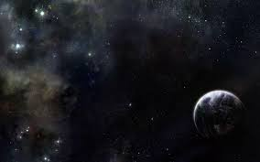
Methodology
Data Collection
Data wrangling
Exploratory data analysis using visualization
Predictive analysis using classification models

Slide 6
Data collection
Data was collected from NASA's exoplanet archive: https://exoplanetarchive.ipac.caltech.edu/cgi-bin/TblView/nph-tblView?app=ExoTbls&config=koi
NASA updates data on Kepler's findings regularly on this website.
The dataset consisted of 8054 rows and 49 columns.

Slide 7
Description of columns in the dataset:
kepid : Unique target identification number, as listed in the Kepler Input Catalog
kepoi_name : A number used to identify and track a KOI
kepler_name: Kepler number name in the form "Kepler-N," plus a lower-case letter, identifying the planet.
koi_disposition: Exoplanet archive disposition, the category of this KOI from the Exoplanet Archive. Current values are CANDIDATE, FALSE POSITIVE, NOT DISPOSITIONED or CONFIRMED.
koi_pdisposition : The pipeline flag that designates the most probable physical explanation of the KOI. Typical values are FALSE POSITIVE, NOT DISPOSITIONED, and CANDIDATE.
koi_score : A value between 0 and 1 that indicates the confidence in the KOI disposition.
koi_fpflag_nt : Not Transit-Like Flag, A KOI whose light curve is not consistent with that of a transiting planet

Slide 8
koi_fpflag_ss : Stellar Eclipse Flag, A KOI that is observed to have a significant secondary event, transit shape, or out-of-eclipse variability, which indicates that the transit-like event is most likely caused by an eclipsing binary.
koi_fpflag_co : Centroid Offset Flag ,The source of the signal is from a nearby star, as inferred by measuring the centroid location of the image both in and out of transit
koi_fpflag_ec : The KOI shares the same period and epoch as another object and is judged to be the result of flux contamination in the aperture or electronic crosstalk.
koi_period: Orbital Period (days),The interval between consecutive planetary transits.
koi_time0bk : The time corresponding to the center of the first detected transit in Barycentric Julian Day (BJD) minus a constant offset of 2,454,833.0 days.
koi_impact : The sky-projected distance between the center of the stellar disc and the center of the planet disc at conjunction, normalized by the stellar radius
koi_duration : The duration of the observed transits in hours. Duration is measured from first contact between the planet and star until last contact.
koi_depth : The fraction of stellar flux lost at the minimum of the planetary transit in ppm.

Slide 9
koi_prad : The radius of the planet (Earth Radii).
koi_teq: Approximation for the temperature of the planet (Kelvin).
koi_insol : Insolation flux, it's given in units relative to those measured for the Earth from the Sun
koi_model_snr : Transit depth normalized by the mean uncertainty in the flux during the transits.
koi_tce_plnt_num : TCE Planet Number federated to the KOI.
koi_tce_delivname : TCE delivery name corresponding to the TCE data federated to the KOI.
koi_steff : The photospheric temperature of the star.
koi_slogg : The base-10 logarithm of the acceleration due to gravity at the surface of the star.
koi_srad : The photospheric radius of the star
ra: KIC Right Ascension
dec: KIC declination
koi_kepmag : Kepler-band (mag) The error terms are uncertainities in the measurements of the values.

Slide 10
Data Wrangling
Assigning numerical values to categorical values for effective modelling.
Dropping nan values and infinity values
Dropping unnecessary columns like id columns and the score column ( as we are trying to predict the predisposition, koi score does not make sense for the test rows) ,duplicate columns and the error columns ( sufficient to consider the approximates)

Slide 11
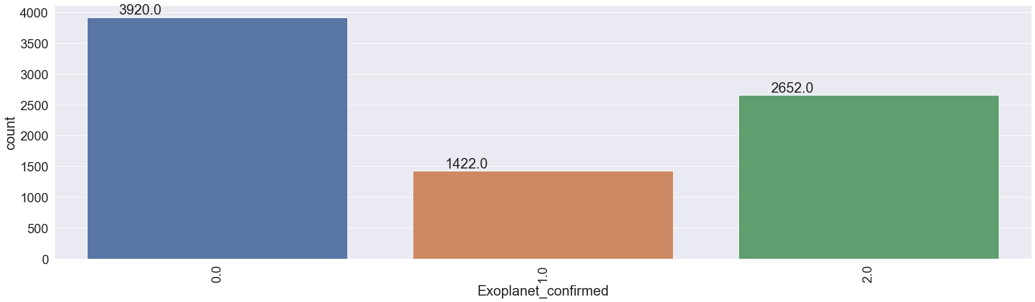
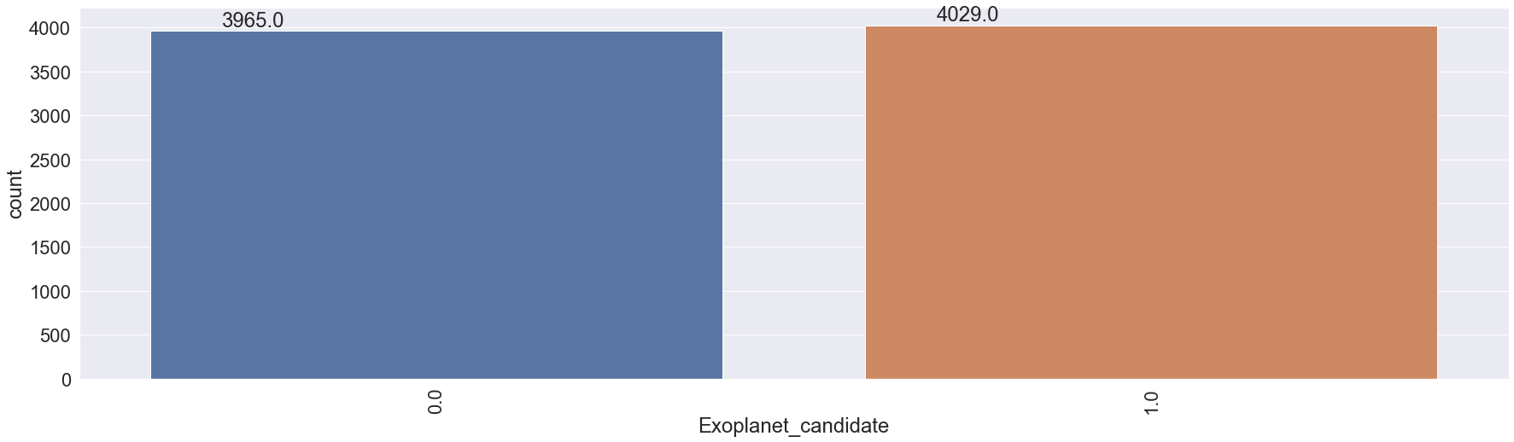
Data Analysis
There are almost equal candidates and non- candidates and among the candidates, almost two thirds are confirmed exoplanets( 2652 out of 4029 )

Slide 12
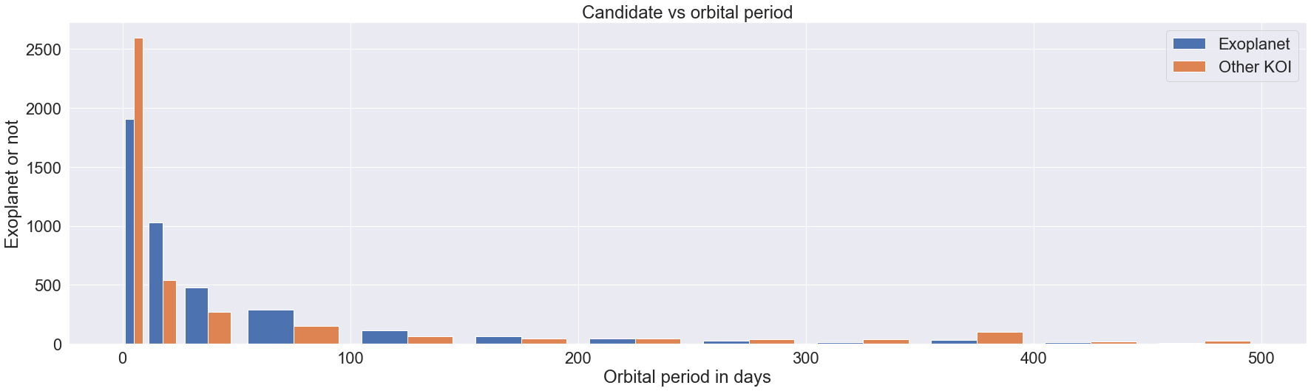
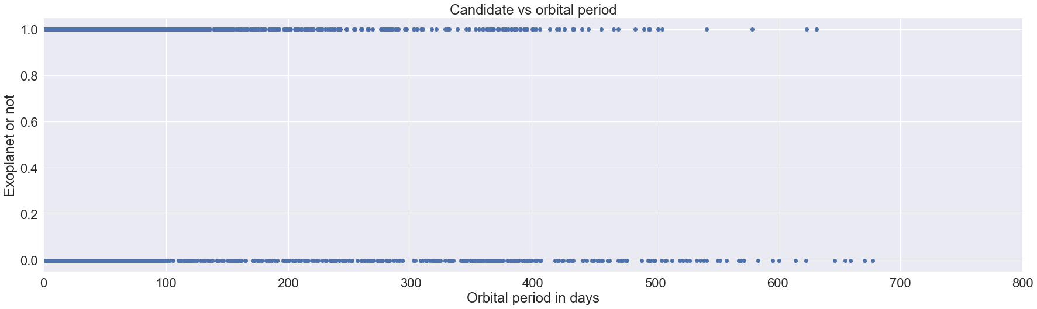
Orbital period
Most exoplanets have an orbital period of less than 100 days, higher orbital periods usually indicate that the KOI is not an exoplanet.

Slide 13
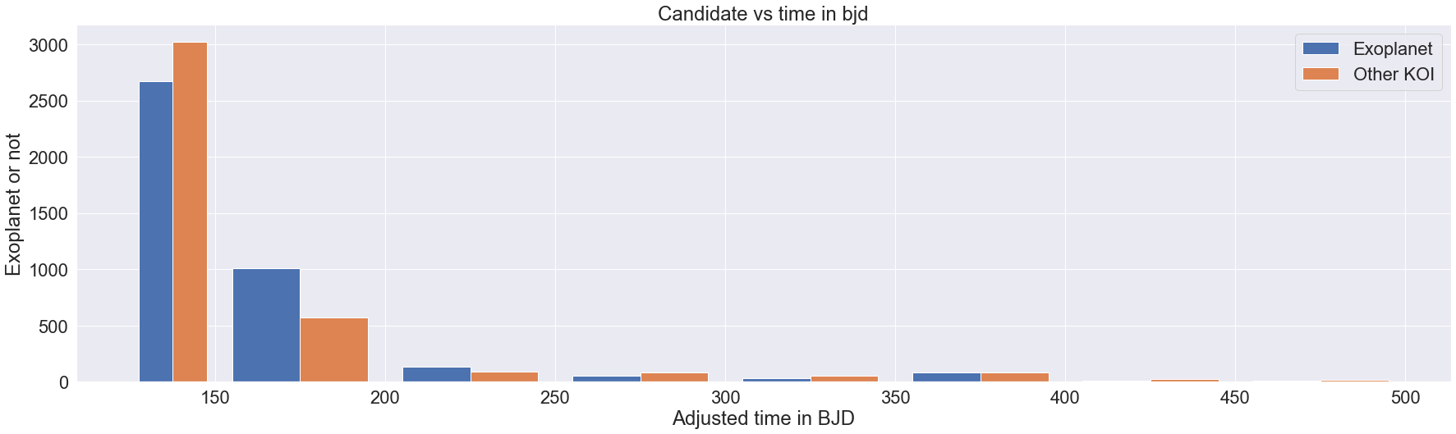
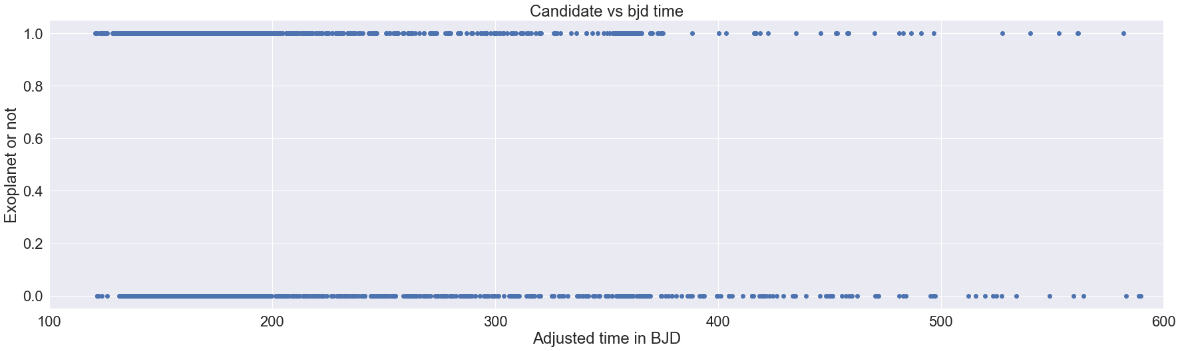
Transit Epoch
Most exoplanets have transit epoch time in between 125 and 200 BJD, a koi with a higher time is most probably not an exoplanet.

Slide 14
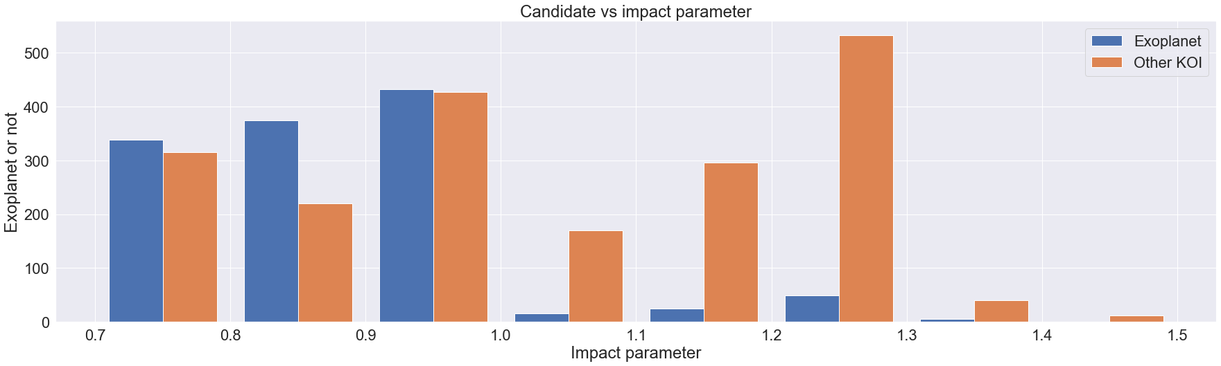
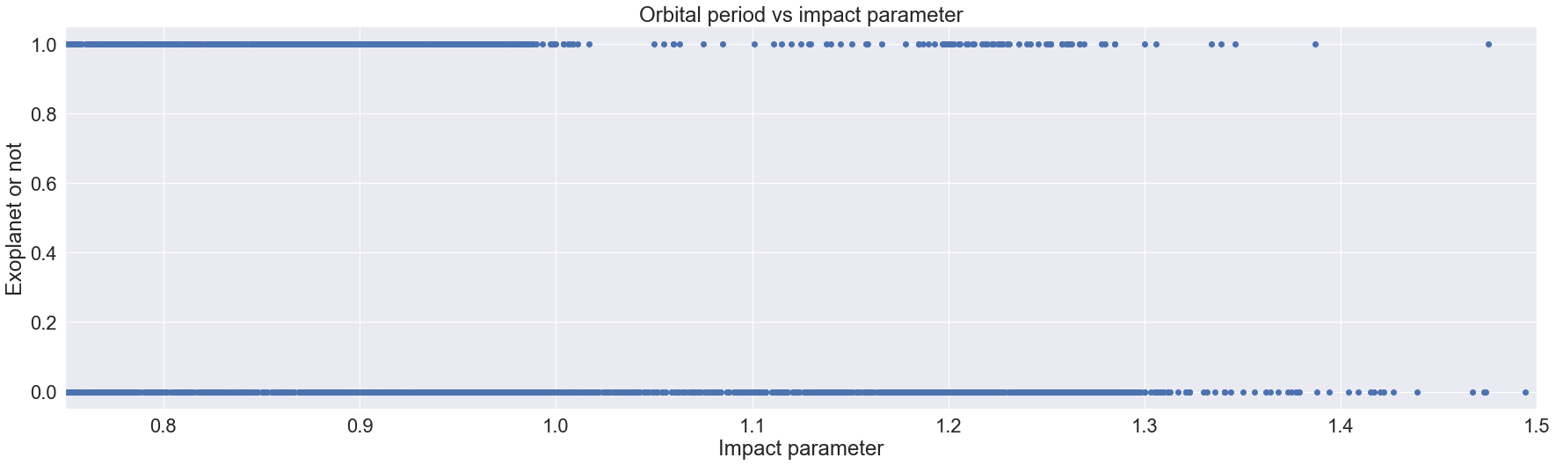
Impact Parameter
Most KOIs with impact parameter above 1 are not exoplanets.

Slide 15
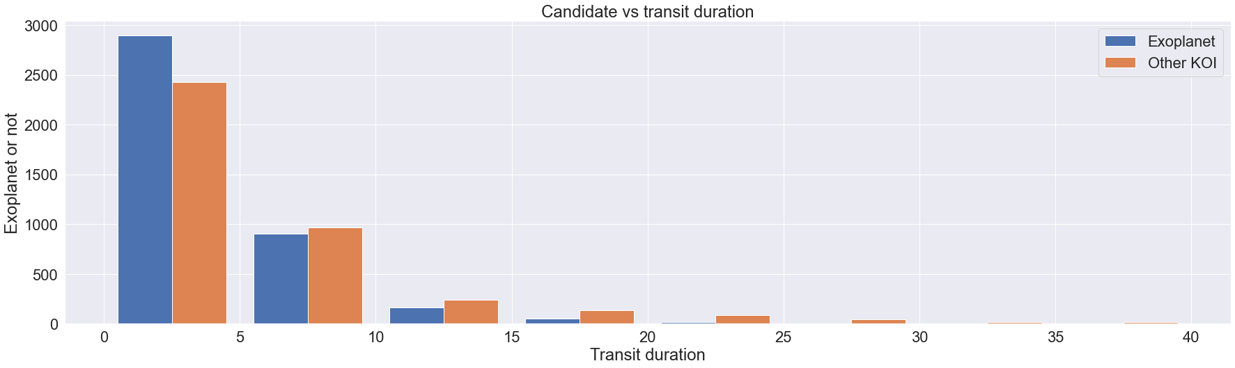
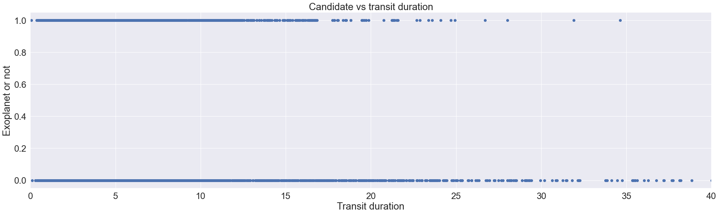
Transit Duration
Most exoplanets have a transit duration of less than 10 hours and any KOI with a duration higher than 15 hours is most probably not an exoplanet.

Slide 16
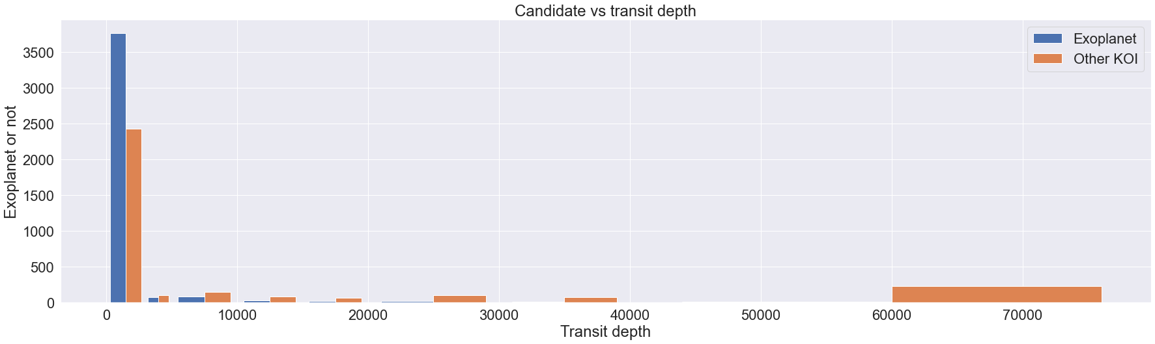
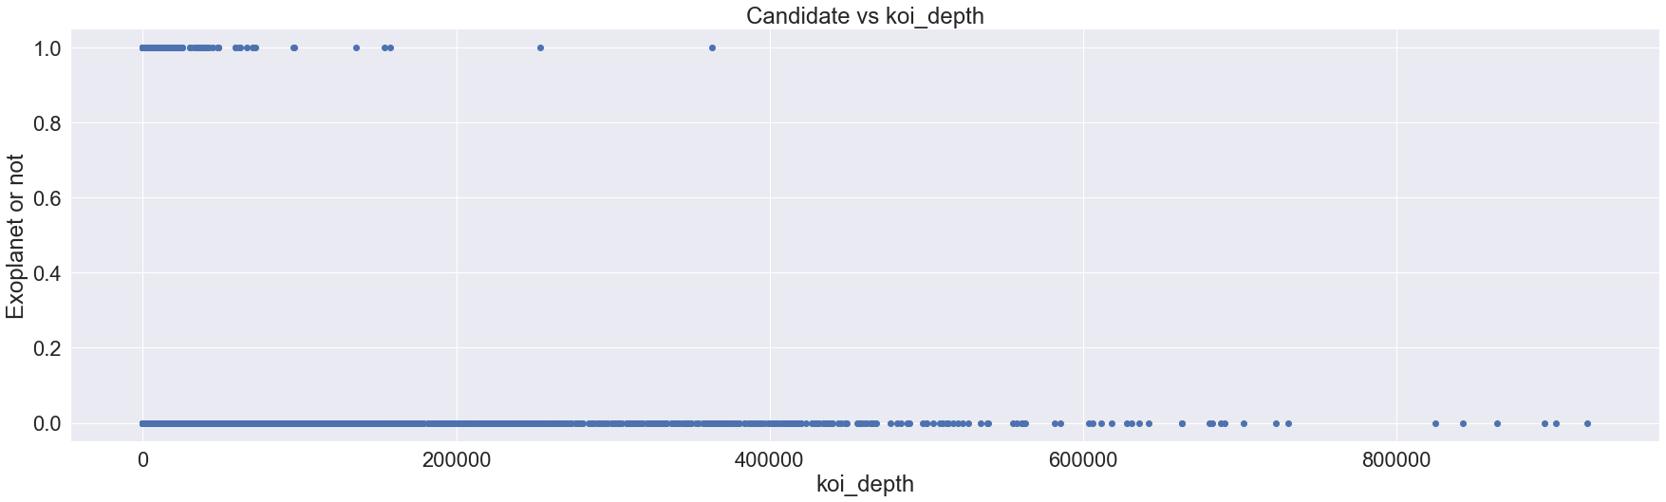
Transit depth
The higher the stellar flux lost at the minimum of the planetary transit in ppm, the less likely that the koi is an exoplanet, and most exoplanets have koi_depth value below 3000

Slide 17
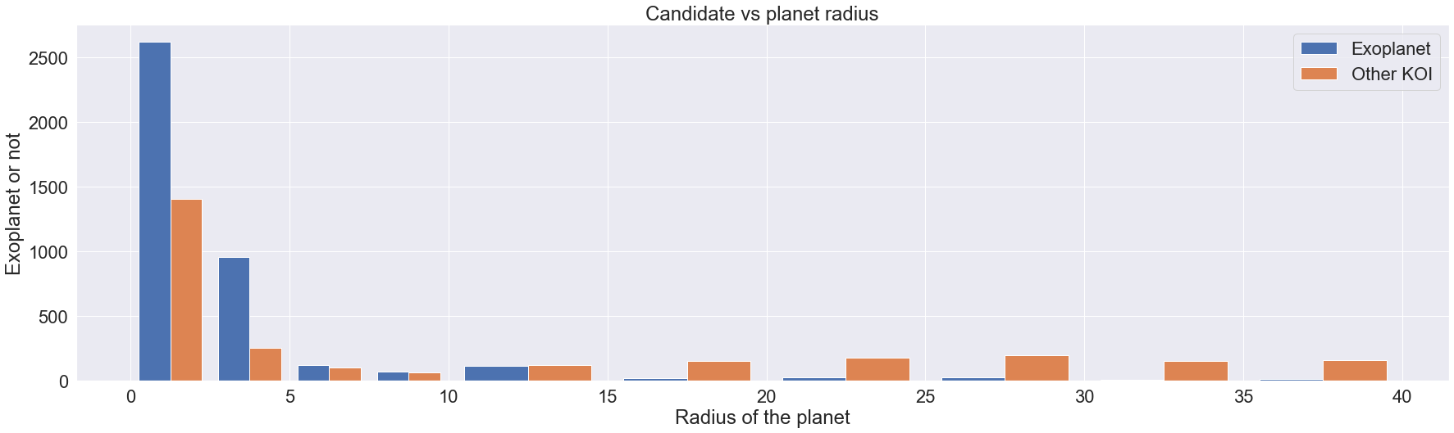
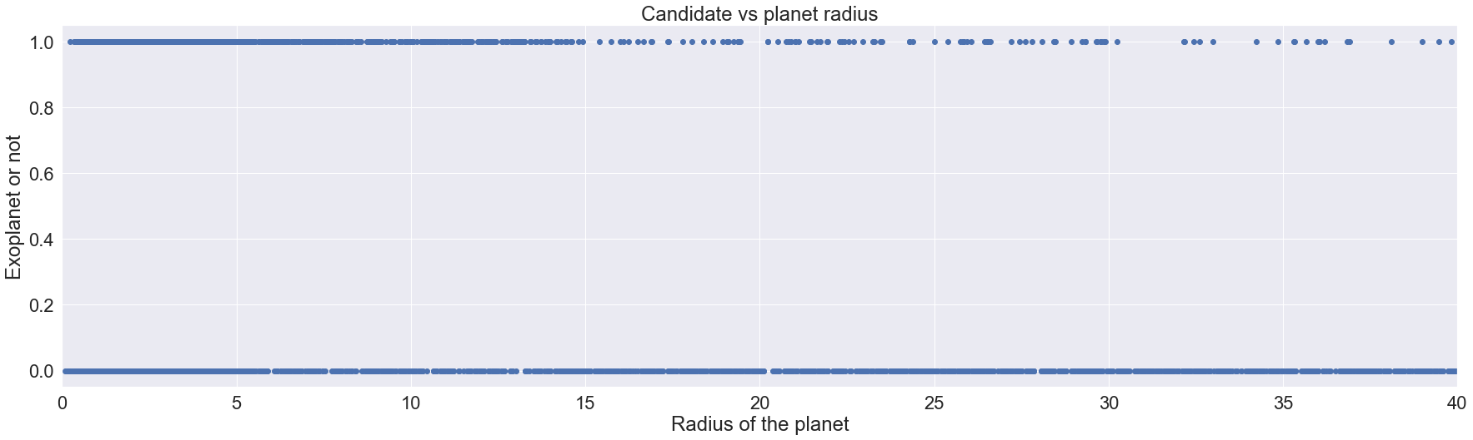
Planet radius
The higher the radius, the less likely that the KOI is an exoplanet, most exoplanets have radius below 5 earth radii, KOIs with radius higher than 15 earth radii are most probably not exoplanets

Slide 18
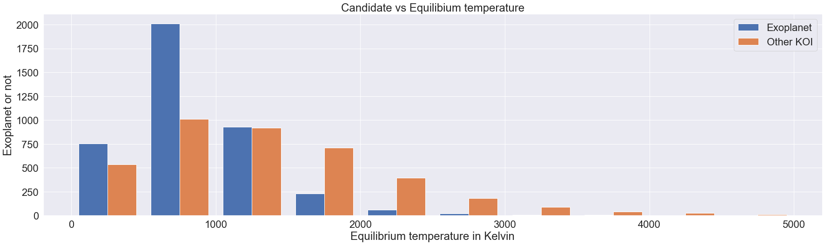
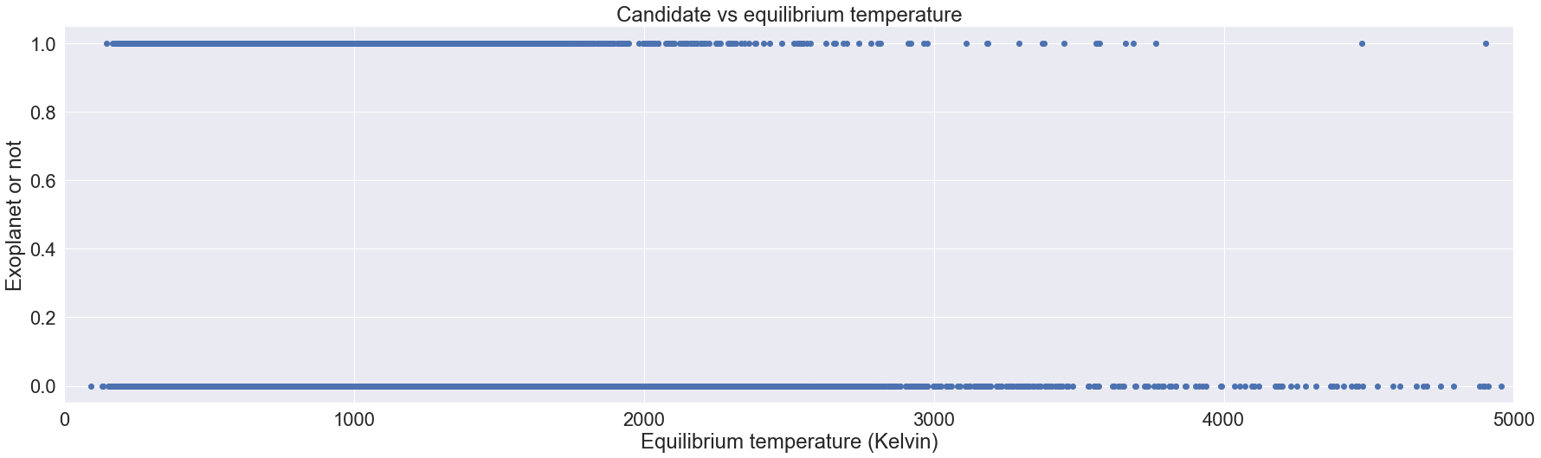
Equilibrium temperature
Most exoplanets have an equilibrium temperature of below 1500K and a koi with higher equilibrium temperature is most probably not an exoplanet
In [224]:

Slide 19
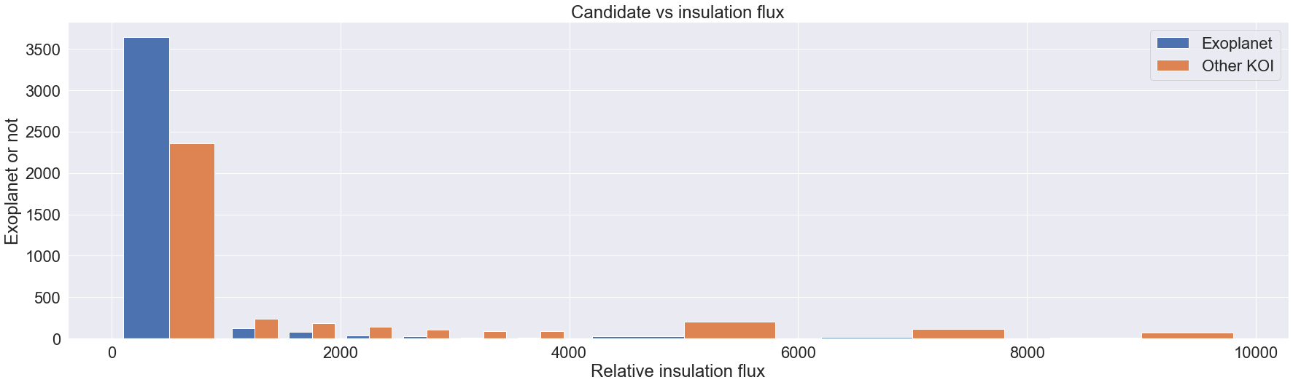
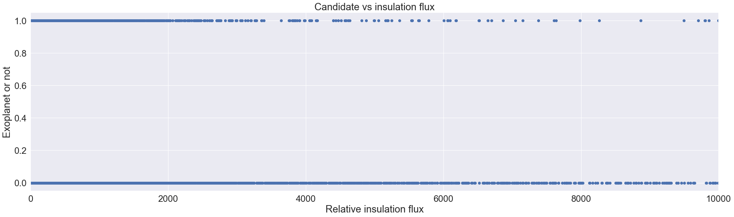
Insulation flux
Most exoplanets have relative insulation flux below 1000, and any KOI with higher flux is most probably not an exoplanet

Slide 20
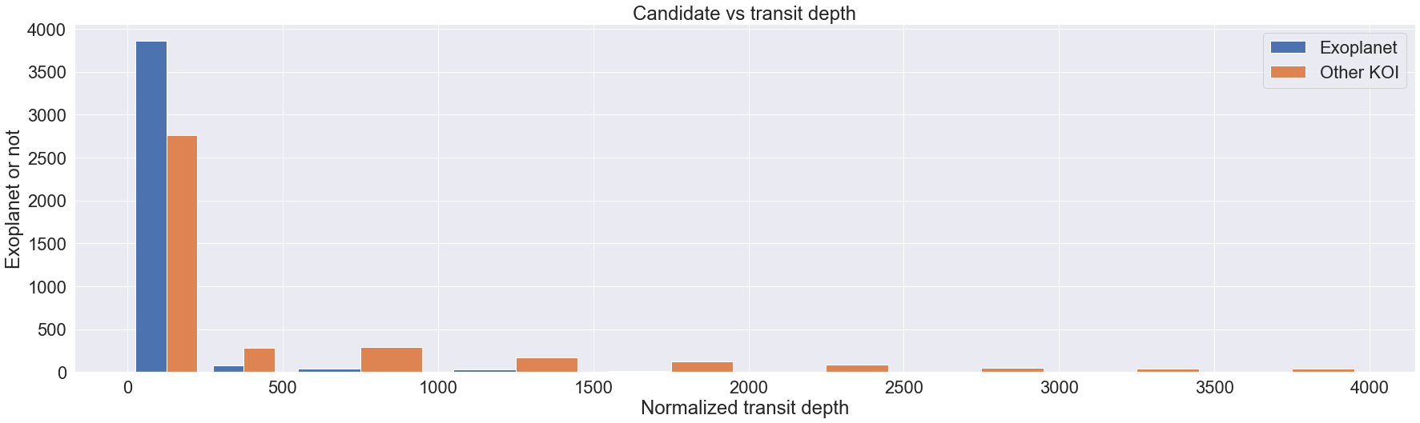
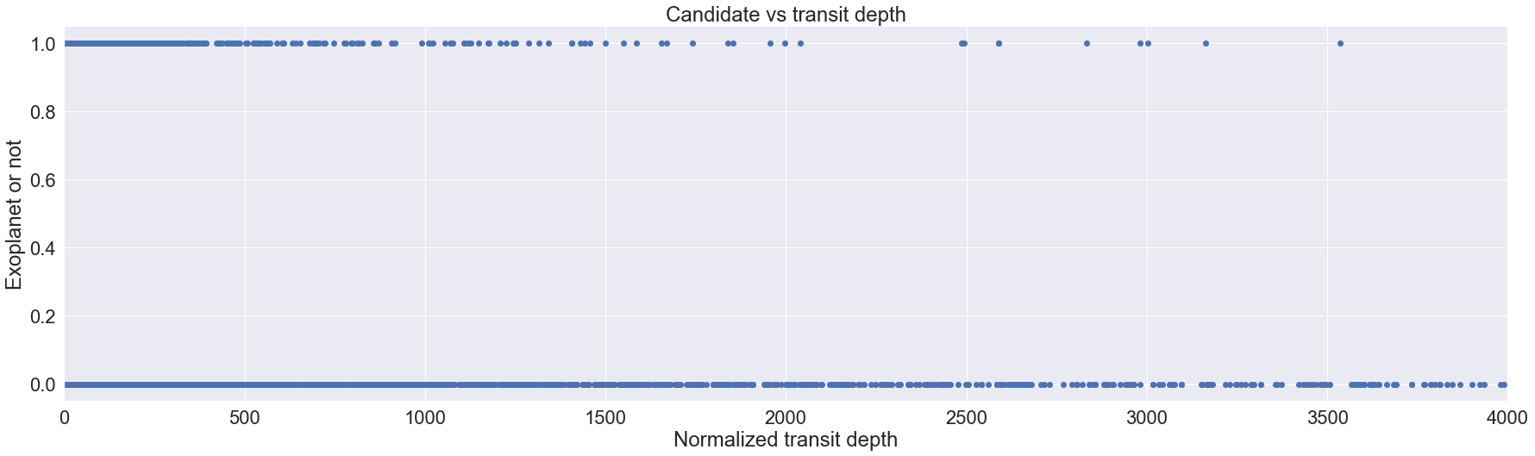
Transit depth
Most exoplanets have relative transit depth below 250 and any KOI with higher transit depth is most probably not an exoplanet

Slide 21
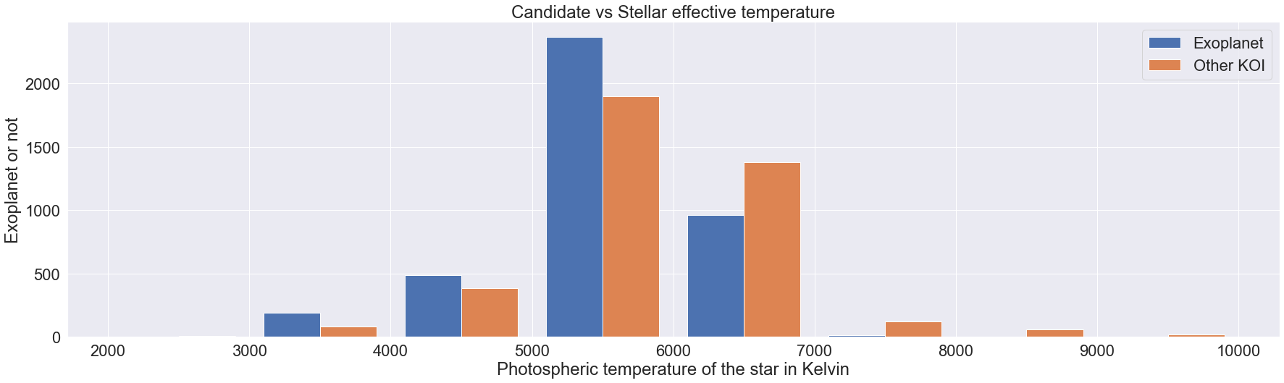
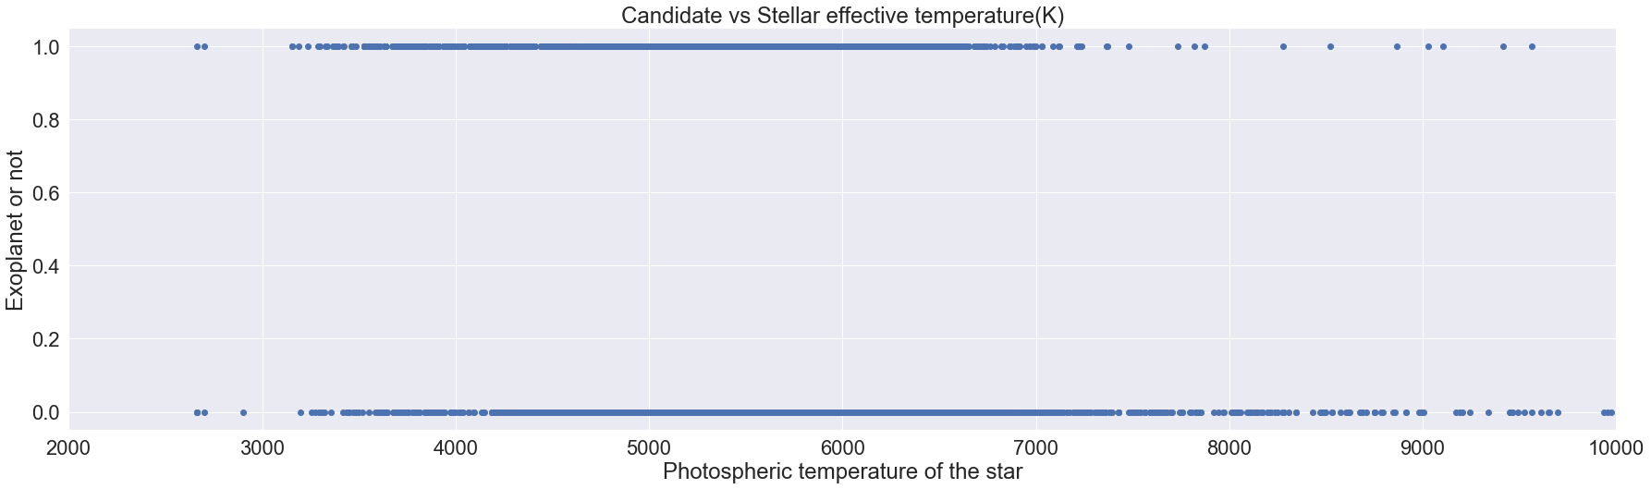
Stellar effective temperature
The photospheric temperature of the star of an exoplanet is most likely in between 3000-7000k and higher temperature KOIs are mostly not exoplanets

Slide 22
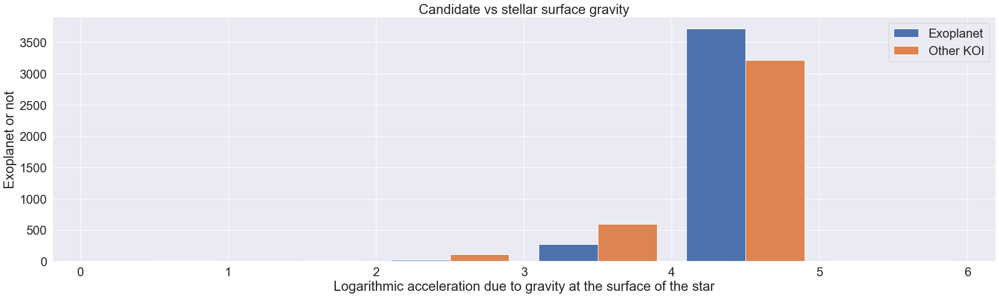
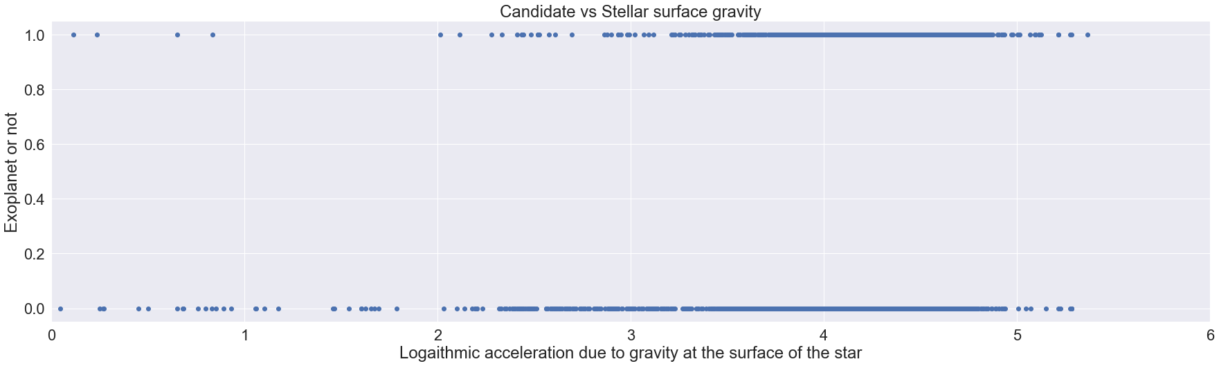
Stellar surface gravity
Most exoplanets have stellar surface gravity between 3 and 5

Slide 23
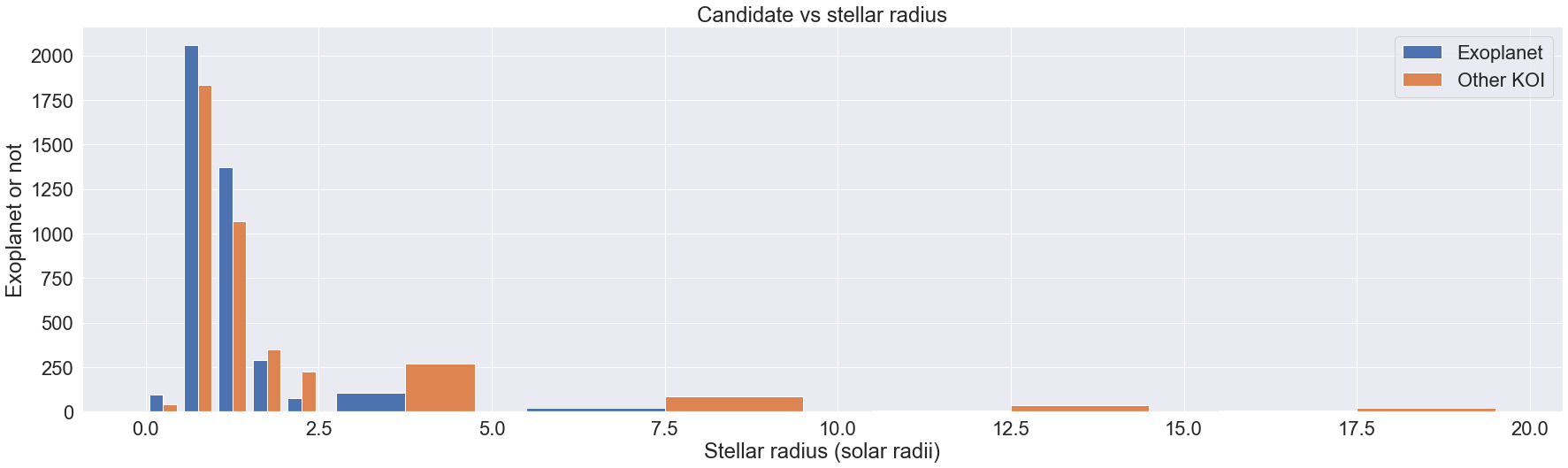
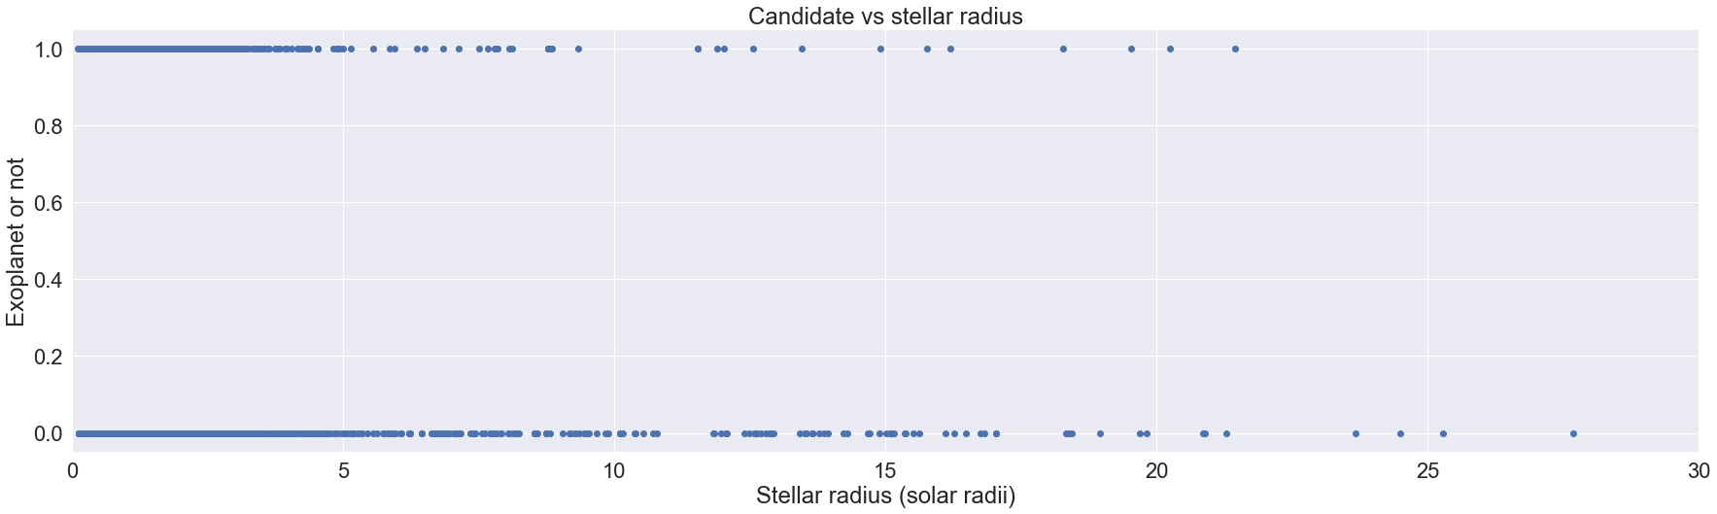
Stellar radius
Most exoplanets have stellar radius less than 1.5 solar radii and a koi with higher stellar radius is most probably not an exoplanet

Slide 24
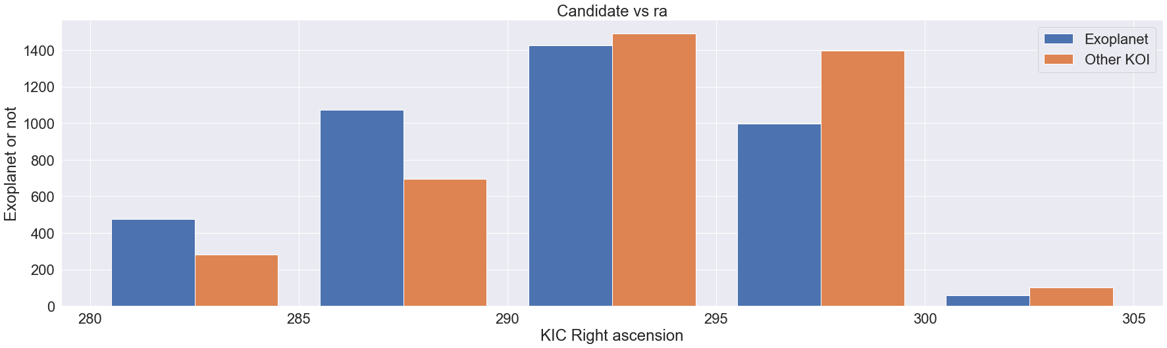
KIC Right ascension
The probability of a KOI being an exoplanet is inversely proportional to the KIC right ascension

Slide 25
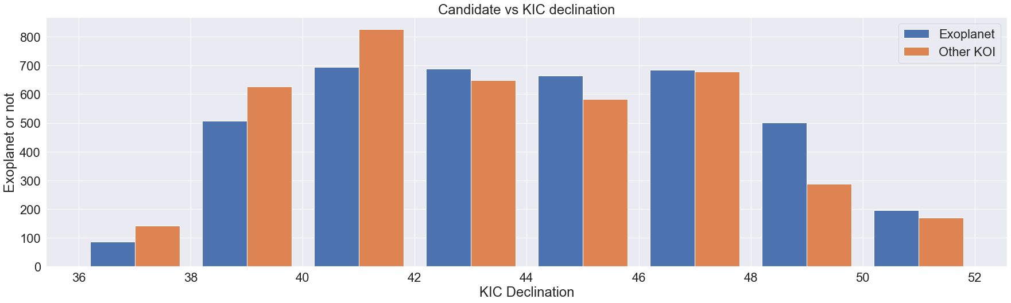
KIC Declination
The probability of a KOI being an exoplanet is directly proportional to the KIC declination.

Slide 26
Models and their performances
1. Logistic Regression
Accuracy: 0.796 Confusion matrix Recall: 0.884 F1 Score: 0.818 Precision: 0.760
1087 | 460
191 | 1460

Slide 27
2.KNeighbours Classifier
Accuracy:0.784 Recall: 0.795 F1 Score: 0.792 Precision: 0.788
Confusion matrix
1195 | 352
339 | 1312

Slide 28
3.Decision Tree Classifier
Accuracy: 0.99 Confusion matrix
Recall:0.988
F1 Score:0.991
Precision: 0.994
1537 | 10
19 | 1632

Slide 29
4.Random Forest Classifier
Accuracy: 0.992 Confusion Matrix
Recall: 0.985
F1 Score: 0.
Precision:
1547 | 0
25 | 1626

Slide 30
Conclusions and results
2652 exoplanets have been confirmed so far by NASA ( as on 14-08-2022)
There are almost equal candidates and non- candidates and among the candidates, almost two thirds are confirmed exoplanets.
Impact parameter, transit duration, flux and radius(planetary and stellar) are some of the most important deciding factors on whether a koi has an exoplanet or not.
We were able to predict with a 99% accuracy whether our observations is an exoplanet or not.
While all models had over 78% accuracy, Random forest classifier was the most accurate model.

Slide 31

Thank you

